Slide 1

Advanced Python
External Data Sources

Slide 2
Module 5: External Data Sources ~ SQLite ~

Slide 3
Module Objectives After completing this module you will be able to
Explain what SQLite is and list SQLite features, advantages and limitations
Install and use SQLite to create & drop tables and to perform CRUD operations on database tables
Save the result of an SQL query into a file
Execute SQL statements from a file
Use SQLite from Python to create/drop tables and perform CRUD operations on database tables with hard-coded values and with runtime binding
Use SQLite from Python to convert the result of an SELECT SQL statement into a Pandas DataFrame

Slide 4
What is SQLite?
SQLite is an open-source, in-process library that implements a SQL (relational) database engine that is:
self-contained: stand-alone, with no external dependencies, running on any operating system,
serverless: no separate system and no intermediary server process needed,
zero-configuration: no need for setup or administration in your system,
transactional: all changes and queries are Atomic, Consistent, Isolated, and Durable (ACID)
A complete SQLite database is stored in a single cross-platform disk file and can be linked with other applications statically or dynamically as per your requirement.
SQLite is small in size (around 500KB).
SQLite accesses its storage files directly.
Notes:
SQLite was designed in 2000 by D. Richard Hipp, for the purpose of no administration required for operating a program.

Slide 5
SQLite Limitations
SQLite supports most of the query language features found in SQL92 (SQL2) standard
However, there are few unsupported features of SQL92 in SQLite which are listed in the following table
Serial No. | Feature | Description
1 | RIGHT OUTER JOIN | Only LEFT OUTER JOIN is implemented.
2 | FULL OUTER JOIN | Only LEFT OUTER JOIN is implemented.
3 | ALTER TABLE | The RENAME TABLE and ADD COLUMN variants of the ALTER TABLE command are supported. The DROP COLUMN, ALTER COLUMN, ADD CONSTRAINT are not supported
4 | Trigger support | FOR EACH ROW triggers are supported but not FOR EACH STATEMENT triggers.
5 | VIEWs | VIEWs in SQLite are read-only. You may not execute a DELETE, INSERT, or UPDATE statement on a view.
6 | GRANT and REVOKE | The only access permissions that can be applied are the normal file access permissions of the underlying operating system.
Notes:
Note: to emulate SQLite full outer join using the UNION and LEFT JOIN clauses, see an example at:
https://www.sqlitetutorial.net/sqlite-full-outer-join/

Slide 6
SQLite Commands
The standard SQLite commands to interact with relational databases are similar to standard SQL
DDL – Data Definition Language:
Serial No. | Command | Description
1 | CREATE | Creates a new table, a view of a table, or other object in database
2 | ALTER | Modifies an existing database object, such as a table
3 | DROP | The RENAME TABLE and ADD COLUMN variants of the ALTER TABLE command are supported. The DROP COLUMN, ALTER COLUMN, ADD CONSTRAINT are not supported
DML – Data Manipulation Language:
Serial No. | Command | Description
1 | INSERT | Creates a record
2 | UPDATE | Modifies records
3 | DELETE | Deletes records
4 | SELECT | Retrieves certain records from one or more tables
Notes:
Note:
As for DCL, the only access permissions that can be applied are the normal file access permissions of the underlying operating system.
The full official SQLite documentation is available at https://sqlite.org/doclist.html
Other useful SQLite Tutorials:
https://www.tutorialspoint.com/sqlite/index.htm
https://www.sqlitetutorial.net/

Slide 7
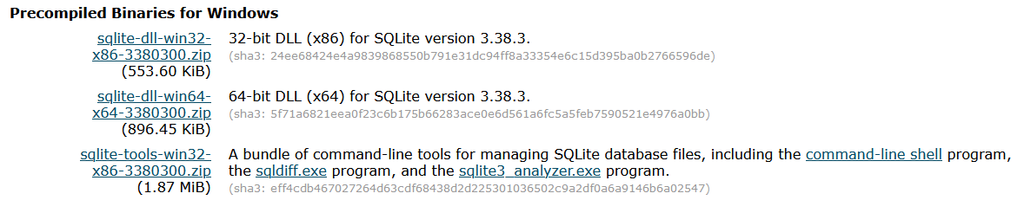
Installing SQLite on Windows
Step 1: go to sqlite.org and press the download button
Step 2: scroll down the page to Precompiled Binaries for Windows and click on the “bundle of command line tools” option, as highlighted below:
Step 3: create the “SQLite” folder, move the downloaded zip file to it and un-compress it, which will give you three executable files: sqldiff, sqlite3 and sqlite3_analyzer
Notes:
The latest version of Mac OS X comes pre-installed with SQLite, and almost all the flavours of Linux OS are being shipped with SQLite.
If you don’t have it on your OS, in step 2 scroll down the page to Precompiled Binaries for Mac OS X (x86) or Precompiled Binaries for Linux, and proceed as above.

Slide 8
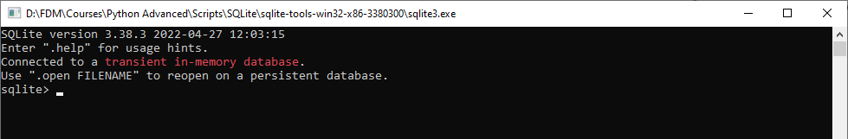
Opening SQLite (create a “connection”)
To open SQLite double click on the executable file named sqlite3, which will open the SQLite command prompt, where you can issue SQLite commands
This has created a command-line utility called “connection”; you can create (open) as many connections as you like, but each one is independent from the other
Aside from the usual SQL commands, in the SQLite command prompt you can also enter other administrative commands, known as “dot commands”, due to the fact that they all start with dot
To list all available dot commands with their short description, type .help

Slide 9
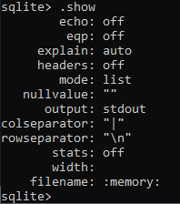
Showing default SQLite settings
To show the default SQLite settings use the .show command
Note the headers and mode default settings from the above screen shot: headers is set to off and mode is set to list – these two settings effect how the output of your queries is shown
.headers on|off Turn display of headers on or off
.mode on off ?OPTIONS? Set output mode

Slide 10

Changing some default SQLite settings
To include columns’ names and correctly align data within the corresponding column name, set the value of headers to 'on' and the value of mode to 'columns', by typing:
Additionally, to show how long it took to execute a query and display its outcome, turn the SQL timer on, by setting the value of timer to 'on’
Note: switching the timer on has an additional advantage: by displaying the run time it confirm that the SQL statement correctly executed, as SQLite otherwise does not produce any message in case SQL statement is successful executed
You are now ready to use SQLite

Slide 11
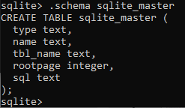
The sqlite_master table
SQLite includes a master table that holds the key information about your database tables and it is called sqlite_master. You can see its schema as follows:
In general, to show the structure (“schema”) of a given tablename, type
sqlite> .schema tablename
If you omit the tablename, the .schema command will show the structures (“schemas”) of all tables
sqlite> .schema
Notes:
Conceptually, a schema is a set of interrelated database objects, such as tables, table columns, data types of the columns, indexes, primary & foreign keys, and so on.

Slide 12

Showing and adding databases & tables
To list all tables in the SQLite database, use the .tables command
sqlite> .tables
To show all databases in the current connection, use the .databases command
The .databases command displays at least one database with the name: main.
There are two ways to add a database in the current SQLite connection:
create a new database
add an existing database

Slide 13

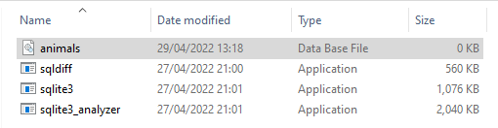
Creating a new database
In SQLite a database is stored in a single file
To create a new or open an existing database use the .open command: .open databasename.db
The .open command will:
close any currently opened database, as only one database in the current SQLite connection can be opened at any point in time
create a new database databasename.db, if the file name databasename.db does not exist in the current working directory
open the database databasename.db, if the file named databasename.db does exist in the current working directory
The two screen shots below show executing the command to create a new database named animals.db, and the outcome in the current working directory
Notes:
Note: The current working directory is the folder where the sqlite3 executable file used to open the current SQLite connection is stored.
If the database is stored in a different folder, the correct path name needs to precede the database name. In windows use back slash (\) to separate folder names; in Mac OS use forward slash (/).

Slide 14
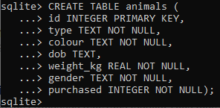

Creating a new table within the database
To create a new table within the opened database, use the CRETE TABLE SQL command
Note: look at the time stamp of the file animals.db (through “Date Modified” file property) in your current working folder to see that the database has changed
Execute the .databases and .tables commands to see the newly created database and its table:
Notes:
Note: SQLite is case insensitive, i.e. the clauses SELECT and select have the same meaning in SQLite statements.
As good practice though, SQLite keywords should be typed in uppercase, to distinguish them from our own names.

Slide 15
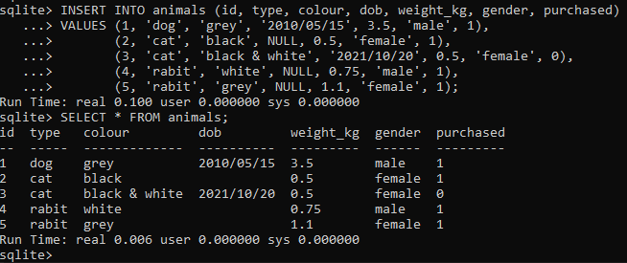
Populating a new table within the database
Let’s add a few records to the animals table in the animals.db database and check if they were inserted
Notes:
Other data types are available. For the full list see https://www.tutorialspoint.com/sqlite/sqlite_data_types.htm
Official link to Datatypes In SQLite: https://sqlite.org/datatype3.html
Note the following:
SQLite does not have a separate storage class for storing dates and/or times, but SQLite is capable of storing dates and times as TEXT, REAL or INTEGER values. You can choose to store dates and times in any of these formats and freely convert between formats using the built-in date and time functions.
SQLite does not have a separate Boolean storage class. Instead, Boolean values are stored as integers 0 (false) and 1 (true).
Unless specified with NOT NULL, by default a table column accepts NULL values. This includes primary key fields except for primary keys defined with INTEGER data type. An attempt to insert a record with NULL value for the INTEGER primary key column will result in the next available sequential integer value assigned for that record. Columns defined as primary key with any other data type will accept NULL values. This is why:
Based on the SQL standard, PRIMARY KEY should always imply NOT NULL. However, SQLite allows NULL values in
the PRIMARY KEY column except when the column is INTEGER PRIMARY KEY column.
This is due to a bug in some early versions. If this bug is fixed to conform with the SQL standard, then it might
break the legacy systems. Therefore, it has been decided to allow NULL values in the PRIMARY KEY column.
To prevent inserting NULL values into primary key columns of data type other than INTEGER, define the
primary key column as NOT NULL. For INTEGER PRIMARY KEY columns, NULL won’t be accepted – instead
the next available sequential integer value will assigned for that record.

Slide 16
Adding additional DB to current connection
When you connect to a database, its name is main regardless of the database file name.
In addition, you can access the temporary database that holds temporary tables and other database objects via the temp database.
Therefore, every SQLite database connection has the main database and also temp database in case you deal with temporary database objects
The ATTACH DATABASE statement adds another database file to the current database connection.
To attach an additional database to the current database connection, you use the ATTACH DATABASE statement as follows:
ATTACH [DATABASE] file_name AS database_name;
The statement includes the database file file_name to the current database connection under the logical database name database_name.
If the database file file_name does not exist, the statement creates a new database file.
Once the additional database is attached, you can refer to all objects in the database under the name database_name.object_name For example, to refer to the people table in the contacts database, you use the contacts.people
Notes:
Note: the keyword DATABASE is optional.
The ATTACH command can be run as either
ATTACH DATABASE file_name AS database_name;
or
ATTACH file_name AS database_name;
Official documentation on ATTACH statement:
https://www.sqlite.org/lang_attach.html

Slide 17
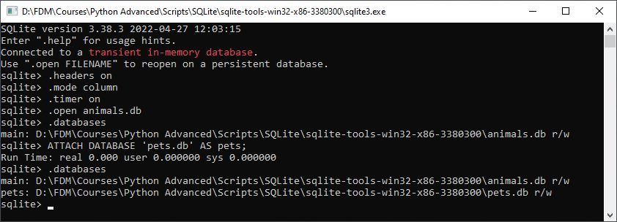
Adding additional DB to current connection
The screen shot below evidences opening the existing database animals.db from the current working folder, listed as main database, then using the ATTACH DATABASE statement to create a new database named pets and include it in the current database connection.
Notes:
Note: the quotes around the database name (here pets.db) are needed. If the database is stored in a different folder, the correct path name needs to precede the database name. In windows use back slash (\) to separate folder names; in Mac OS use forward slash (/).
https://www.sqlitetutorial.net/sqlite-attach-database/

Slide 18
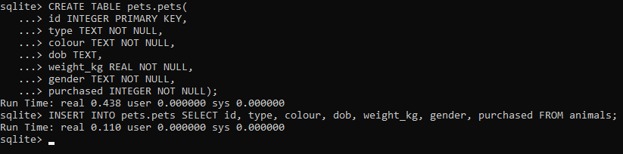
Adding additional DB to current connection
We can now create a new table named pets in the pets database and populate data from the animals table in the main database:
Notice that we referred to the pets table in the pets database using the pets.pets naming convention.
Notes:
https://www.sqlitetutorial.net/sqlite-attach-database/

Slide 19
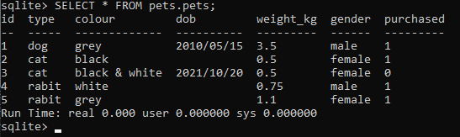
Adding additional DB to current connection
Finally, query data from the pets table in the pets database.

Slide 20

Removing a DB from the current connection
Database files that were previously attached can be removed using the DETACH DATABASE command:
DETACH [DATABASE] database_name;
The screen shot below evidences detaching the attached database pets from the current connection, leaving the current connection with only the main database: animals
Notice that we refer to the pets database as pets (as opposed to pets.pets, which refers to the table pets in pets database).
In general, to refer to a table within an attached database we write: databasename.tablename
Notes:
Note: the keyword DATABASE is optional.
The DETACH command can be run as either
DETACH DATABASE database_name;
or
DETACH database_name;
https://www.techonthenet.com/sqlite/detach_database.php
Official documentation on DETACH statement:
https://www.sqlite.org/lang_detach.html

Slide 21

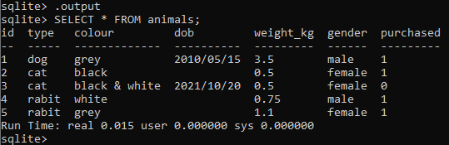
Saving the result of a query into a file
To save the result of a query into a file, use the .output FILENAME command.
Once you issue the .output command, all the results of the subsequent queries will be saved to the file that you specified in the FILENAME argument.
To display the result of the query to the standard output again, issue the .output command without arguments, or re-set the default output setting: .output stdout
Notes:
https://www.sqlitetutorial.net/sqlite-commands/
https://www.sqlitetutorial.net/sqlite-export-csv/

Slide 22
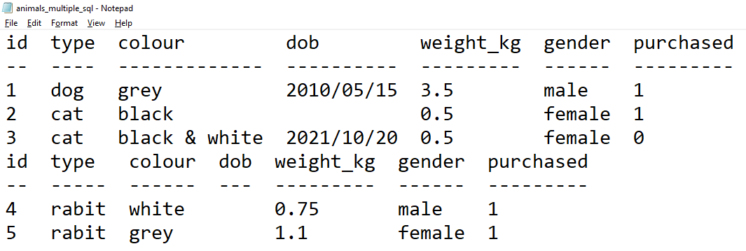
Saving the result of a query into a file
The file created by saving the two SQL statements executed in the previous slide is shown below:
Notes:
https://www.sqlitetutorial.net/sqlite-commands/
https://www.sqlitetutorial.net/sqlite-export-csv/

Slide 23
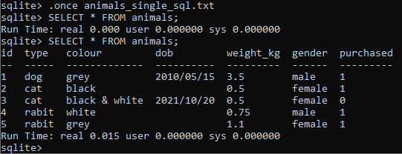
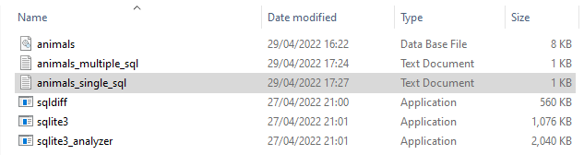
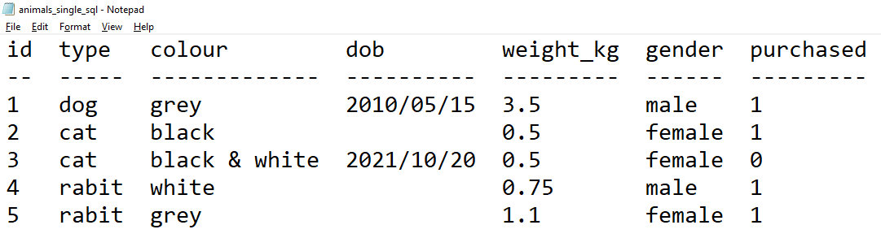
Saving the result of a query into a file
If you want to save the result of the next single query only to the file, you issue the .once FILENAME command; all subsequent queries will be redirected to stdout (command line console).
Notes:
https://www.sqlitetutorial.net/sqlite-commands/
https://www.sqlitetutorial.net/sqlite-export-csv/

Slide 24
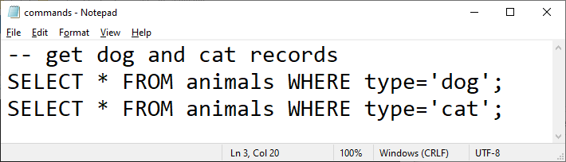
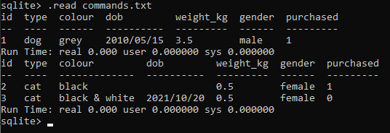
Executing SQL statements from a file
Suppose we have a file named commands.txt in the current working folder with the following content:
To execute the SQL statements in the file FILENAME, use the .read FILENAME command:
Notes:
SQLite comments:
single-line comments begin with two consecutive dash (-) characters: --
multi-line comments begin with /* and end with */ (aka “C-style” comments)
To exit the sqlite3 program, use the .exit command.

Slide 25
Using SQLite from Python
The Python Standard Library includes a module called "sqlite3" intended for working with SQLite
It will have to be imported though:
>>> import sqlite3
Once sqlite3 module has been imported, we need to connect to a database:
>>> conn = sqlite3.connect('animals.db')
If the database does not exist, then it will be created
In both cases, a database connection object will be returned.
>>> print('returned connection object:', conn) returned connection object: <sqlite3.Connection object at 0x037A2020>
Next, we need to create a cursor object to store the outcome of the SQL statement (e.g. the row(s) returned)
>>> cursor = conn.cursor()

Slide 26
Using SQLite from Python
In the next step we need to pass the SQL statement to the cursor object to execute it
>>> cursor.execute("INSERT INTO animals \
(id, type, colour, dob, weight_kg, gender, purchased) \
VALUES \
(6, 'horse', 'brown', '2018/07/05', 200, 'male', 1)")
In case the executed SQL statement affected data (i.e. INSERT, UPDATE, DELETE) or table (i.e. CREATE, ALTER, DROP), it is necessary to commit the changes to make them visible from other database connections
>>> conn.commit()
In case the executed SQL statement did not affect data or table (i.e. SELECT), we can use fetchall() cursor method to fetch all rows – the rows will be stored in a list as tuples
>>> cursor.execute('SELECT * FROM animals')
>>> rows = cursor.fetchall() # retrieves all rows as a list of tuples
Notes:
Notes:
The commit function is invoked on the connection object, not the cursor object. The cursor object has no attribute 'commit’.
Remember to always call commit to save the changes. If you close the connection using close or the connection to the file is lost (e.g. the program finishes unexpectedly), not committed changes will be lost.
There is also fetchone() cursor method, which retrieves a single (next) row, or None if there are no rows.
However, the cursor is implemented as an iterator, keeping track of what row/rows has/have been fetched.
This means that if you use fetchone() before fetchall(), fetchone() will retrieve the first row returned by the executed SQL statement, and fetchall() will return the remaining one(s), excluding the already returned first row.
By specifying the number of rows to return as an argument to the fetchall() cursor method, that number of
records at a time will be returned upon each call of fetchall(). This is useful if the expected overall number of
rows to be returned is huge.
https://www.tutorialspoint.com/python_data_access/python_sqlite_cursor_object.htm

Slide 27
Using SQLite from Python
Next, loop through the list to display the rows (each row is in form of a tuple):
>>> for row in rows: print(row)
>>> print('The number of fetched records:', len(rows))
Finally, when we are done working with the database we need to close the connection:
>>> conn.close()
Note: we can avoid creating the cursor explicitly and in case of SELECT using the fetchall() method; instead, we can store the rows returned in one equivalent line of code (shortcut) that implicitly creates an intermediate cursor object, before calling the cursor's execute method:
>>> conn = sqlite3.connect('animals.db') >>> rows = conn.execute('SELECT * FROM animals') # returns a cursor object
We can now loop through the cursor rows to display the rows (each row is in form of a tuple):
>>> for row in rows: print(row)
>>> conn.close()
Notes:
To apply the shortcut method to SQL statements that modify data or table, there is no need to save the outcome into the cursor; simply execute the SQL Statement, for example:
conn.execute("DELETE FROM animals WHERE id = 6")
conn.execute('''INSERT INTO animals
(id, type, colour, dob, weight_kg, gender, purchased)
VALUES
(6, 'horse', 'brown', '2018/07/05', 200, 'male', 1)'‘’)
conn.execute(‘UPDATE animals SET weight_kg = 190 WHERE id = 6’)
conn.execute('DROP TABLE animals’)
Note however that without using fetchall(), you won’t have an easy way to work out the number of returned rows. To obtain the number of rows returned by the SELECT statement, set up the counter that is incremented every time a row is printed out.

Slide 28
SQLite with runtime binding (1)
Arguments for SQL statements can also be provided dynamically, in runtime:
import sqlite3
try:
conn = sqlite3.connect('animals.db’)
cursor = conn.cursor()
# obtain data in runtime (e.g. entered by the user)
animal_type, colour, dob, weight_kg, gender, purchased = input('enter values for: type, colour, dob, weight_kg, gender, purchased:\n').split()
runtime_data=(animal_type, colour, dob, weight_kg, gender, purchased)
sql = '''INSERT INTO animals
(id, type, colour, dob, weight_kg, gender, purchased)
VALUES(NULL, ?, ?, ?, ?, ?, ?)'''
# execute the sql statement with the data obtained in runtime
cursor.execute(sql, runtime_data)
Notes:
Note: when primary key of a table is of integer data type, an attempt to insert a record with NULL value for the INTEGER primary key column will result in the next available sequential integer value assigned for that record

Slide 29
SQLite with runtime binding (2)
print("Record successfully inserted into table 'animals'.")
# commit the change
conn.commit()
# verify if the new record is inserted
rows = cursor.execute('SELECT * FROM animals')
for row in rows: print(row)
# catch any exceptions
except Exception as e:
# roll back any change if something goes wrong
conn.rollback()
print(e)
finally:
# close the db connection
conn.close()

Slide 30
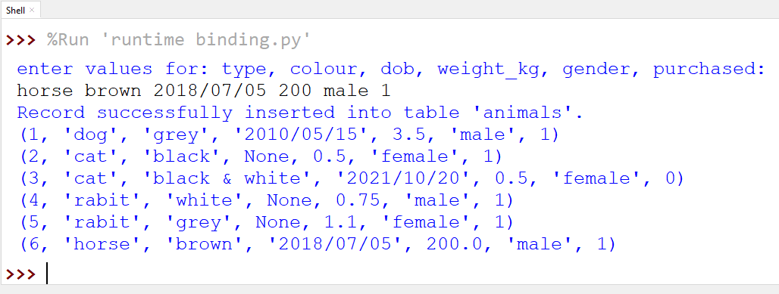
SQLite with runtime binding (3)
If the animals table exists within the animals database, with the 5 records as shown on slide 15, the script produces the following outcome:
Notes:
Note: following the comment on slide 28, inserting the new record with id value set to NULL causes the next available sequential id to be generated (here the max id was 5, hence 6 will be generated); therefore the new record will be inserted with the id value of 6.

Slide 31
SQLite with Pandas (1)
Pandas includes the function read_sql_query(), that executes a query passed to it as 1st argument against the connection object passed to it as 2nd argument, and returns a DataFrame corresponding to the result of the query:
import sqlite3
import pandas as pd
try:
conn = sqlite3.connect('animals.db')
df_query = pd.read_sql_query("select * from animals", conn)
print(df_query)
except Exception as e:
conn.rollback()
print(e)
finally:
conn.close()
Notes:
Official documentation on read_sql_query():
https://pandas.pydata.org/pandas-docs/stable/reference/api/pandas.read_sql_query.html

Slide 32
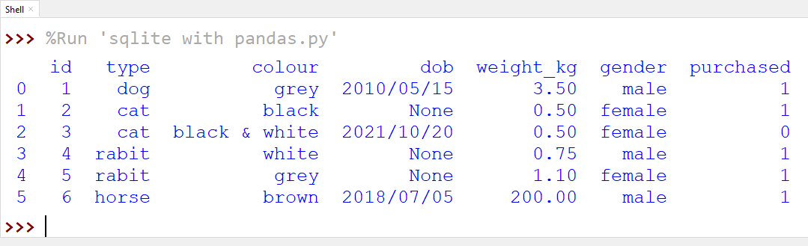
SQLite with Pandas (2)
If the animals table exists within the animals database, with the 6 records as shown on slide 30, the script from previous slide produces the following outcome:

Slide 33

Questions

Slide 34
Module Summary
SQLite is an open-source, in-process library that implements a self-contained, serverless, zero-configuration, transactional SQL (relational) database engine.
A complete SQLite database is stored in a single file, small in size
SQLite supports most of the query language features found in standard SQL
Running the sqlite3 executable creates a command-line utility called “connection”; you can create (open) as many connections as you like, but each one is independent from the other
Aside from the usual SQL commands, in the SQLite command prompt you can also enter other administrative commands, known as “dot commands”; to list all available dot commands with their short description, type .help
Always include the following 3 dot commands in SQLite: .headers on, .mode column, .timer on

Slide 35
Module Summary
To create a new database or open an existing database use the .open command:
.open databasename.db
Execute the .databases and .tables commands to see the available databases and tables
The ATTACH DATABASE statement adds another database file to the current database connection
ATTACH [DATABASE] file_name AS database_name;
Database files that were previously attached can be removed using the DETACH DATABASE command:
DETACH [DATABASE] database_name;
To save the result of a query into a file, use the .output FILENAME command.
To display the result of the query to the standard output again, write either .output or .output stdout

Slide 36
Module Summary
To execute the SQL statements in the file FILENAME, use the .read FILENAME command
To work with SQLite in Python do the following:
import sqlite3 # import the sqlite3 module
conn = sqlite3.connect('...') # connect to a database
cursor = conn.cursor() # create the cursor object
cursor.execute('...') # execute the SQL statement
conn.commit() # needed if the SQL statement affected the table or its data
rows = cursor.fetchall() # to retrieve all rows returned by SELECT statement
for row in rows: # display the rows returned by SELECT statement print(row)
print('The number of fetched records:', len(rows))
conn.close() # close the database connection

Slide 37
Module Summary
To execute the SQL statements with data obtained in runtime, store the data into a tuple and pass it to the execute cursor method along with the SQL statement:
cursor.execute(sql, runtime_data)
To store the row(s) returned by an SQL statement into Pandas DataFrame use the read_sql_query() Pandas method
import sqlite3
import pandas as pd
conn = sqlite3.connect('...')
df_query = pd.read_sql_query('...', conn)

